Slide 1

Data Analysis Report for Fond Rouge
Analysis of Sales, Returns, and Customer Sentiment

Slide 2


Agenda
01
02
03
Introduction
Key Findings
Geographical Patterns
Overview of the analysis scope and methodology
Critical insights from our data analysis
Location-specific challenges and trends
04
05
Root Cause Analysis
Recommended Actions
Exploring possible causes behind the issues
Strategic next steps for improvement

Slide 3

Critical Finding: San Diego Returns Crisis
Our analysis reveals a significant revenue challenge in San Diego, where returns are severely impacting profitability.
54.43%
The numbers tell a stark story: For every pound of revenue generated, we're losing over half to refunds.
Refund-to-Revenue Ratio
The highest amongst all markets
£24.8K
Total Refunds
Substantial financial impact
£45.6K
Total Revenue
Net revenue generation

Slide 4

Geographical Patterns Reveal Troubling Trends
High Return Locations
Counterfeit Activity Indicators
Cities such as San Diego demonstrate disproportionately high return rates, significantly exceeding national averages and eroding profit margins.
Locations including Las Vegas and Los Angeles exhibit concerning patterns consistent with potential counterfeiting behaviour.
This pattern suggests localised operational or product-related issues requiring immediate investigation.
These indicators include unusual purchasing patterns, high return rates of specific products, and suspicious transaction characteristics.

Slide 5
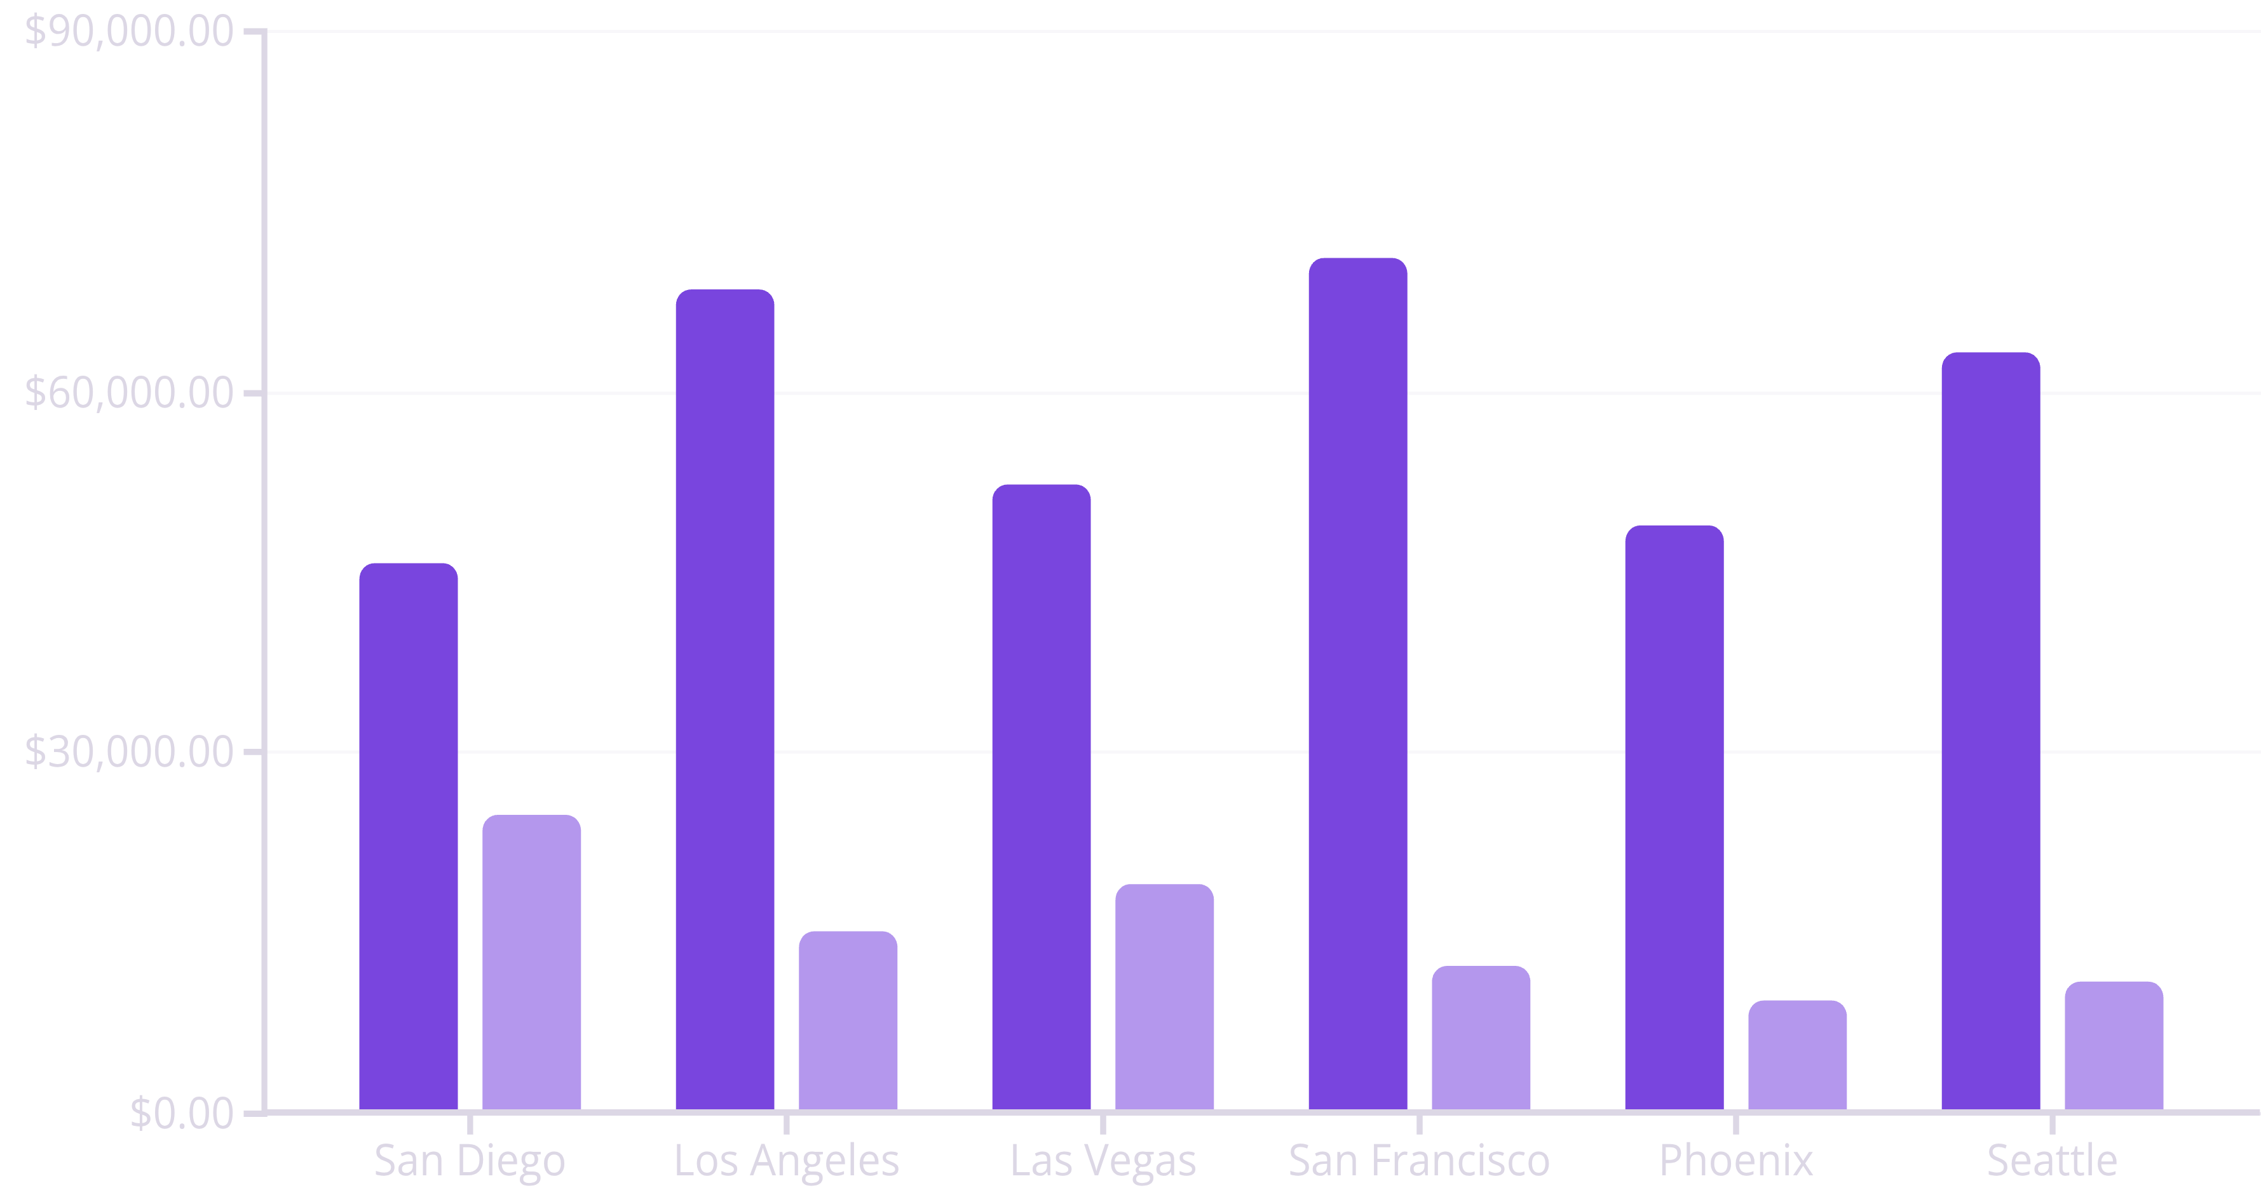
Revenue and Refunds Across US Cities
This analysis highlights the stark contrast between revenue generation and refund losses across our major US markets. San Diego's disproportionate refund ratio stands out as an immediate concern.
Revenue
Refunds

Slide 6

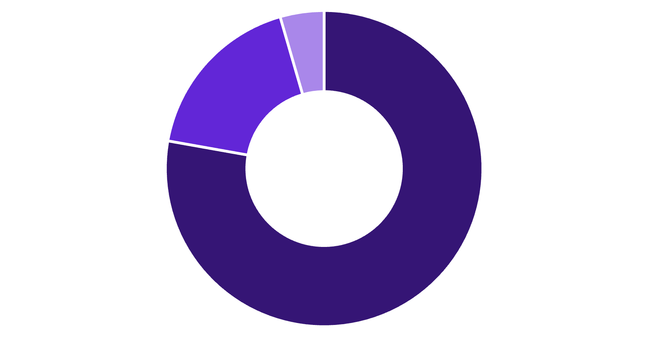
Customer Sentiment Analysis
Sentiment analysis reveals a concerning disparity between our US market and global performance, with negative sentiment concentrated in problematic regions.
United States Market
Global Market
Positive
Neutral
Negative
Positive
Neutral
Negative
23.89% of US sales show negative sentiment—a critical indicator of customer dissatisfaction.
Global markets show only 4.25% negative sentiment—demonstrating that US challenges are localised, not systemic.

Slide 7

Potential Root Causes
Product Quality Issues
Possible manufacturing defects or quality control lapses specific to US-distributed products
Supply Chain Vulnerabilities
Counterfeit products entering distribution channels in high-risk cities
Customer Expectations Mismatch
Product descriptions or marketing materials not aligning with actual product features
Return Policy Exploitation
Lenient return policies being taken advantage of in specific markets

Slide 8




Strategic Next Steps
Combat Counterfeit Activity
Enhance Customer Experience
Implement robust authentication systems and work with local authorities in Las Vegas and Los Angeles to identify and eliminate counterfeit sources.
Launch targeted customer satisfaction initiatives in high-return locations, focusing on product education, improved support, and clearer communication.
Operational Improvements
Deep-Dive Investigation
Refine return policies, enhance quality control measures, and strengthen distribution channel oversight to prevent future issues.
Conduct comprehensive root cause analysis in San Diego, including customer interviews, product quality audits, and operational reviews.

Slide 9

Expected Impact and Timeline
Immediate Actions (0-30 days)
1
Deploy counterfeit detection protocols and initiate San Diego investigation
2
Short-term Goals (1-3 months)
Reduce return rates by 15% through improved quality control and customer support
Medium-term Objectives (3-6 months)
3
Achieve 25% reduction in negative sentiment scores across problem markets
4
Long-term Vision (6-12 months)
Establish sustainable operational excellence with return rates below 15% across all markets

Slide 10

Conclusion and Way Forward
The data reveals clear challenges, but also clear opportunities. By addressing the specific issues in San Diego, combating counterfeit activity, and improving customer satisfaction, we can significantly improve our bottom line and market reputation.
The path forward is clear: Immediate action on high-return locations, robust anti-counterfeit measures, and sustained focus on customer experience will transform these challenges into competitive advantages.
Our analysis provides the roadmap—now it's time to execute with precision and urgency.

